Slide 1
DriverPass System Design
Jeremiah (Jay) Case
CS 255
Southern New Hampshire University
Notes:
This presentation provides an overview of the DriverPass system design. It explains how the system meets the needs of the client by supporting user accounts, scheduling driving lessons, and providing training resources. The goal is to create a system that is easy to use, reliable, and accessible.

Slide 2
System Description
Online driver training system
Supports scheduling and learning
Accessible from web and mobile
Designed for customers and staff
Notes:
The DriverPass system is an online platform designed to help users prepare for their driving tests. It allows customers to create accounts, schedule driving lessons, and access study materials. The system is accessible through web browsers on both computers and mobile devices, making it convenient for users. It also supports employees and administrators who manage scheduling and system operations.

Slide 3
System Requirements
Users can create accounts
Users can schedule driving lessons
Secure login system
Supports multiple users
Notes:
The system is designed to allow users to create accounts and schedule driving lessons online. These features provide convenience and flexibility for customers. The system also includes secure login functionality to protect user information. In addition, it is designed to support multiple users at the same time, ensuring reliable performance.

Slide 4
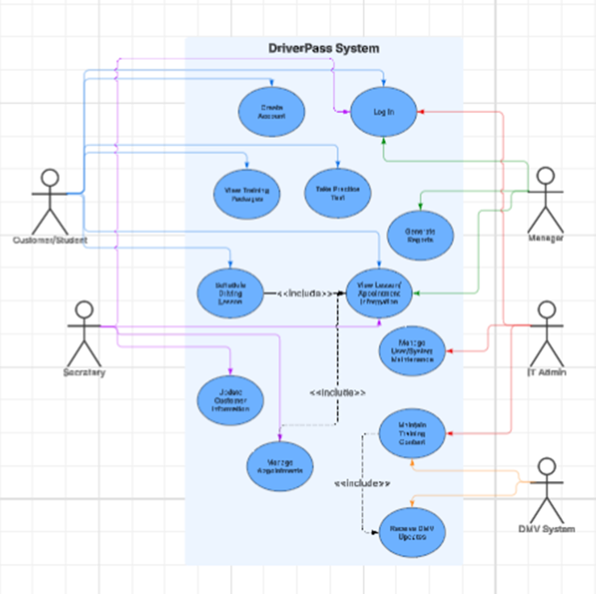
Use Case Diagram
Notes:
This diagram shows how users interact with the DriverPass system. Customers can create accounts, log in, schedule lessons, and access training materials. Employees and administrators manage schedules and system operations. This ensures that all users can complete their tasks efficiently.

Slide 5
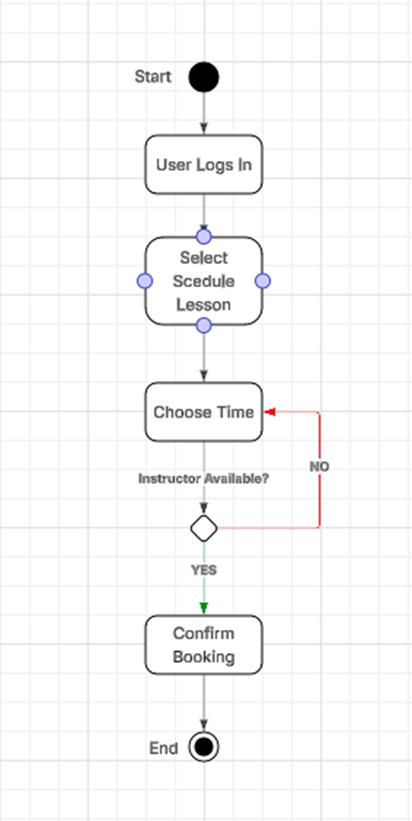
Activity Diagram
Notes:
This diagram shows the process of scheduling a driving lesson. The user logs in, selects a lesson time, and the system checks instructor availability. If the selected time is not available, the user is prompted to choose another time. Once a valid time is selected, the system confirms the appointment.

Slide 6
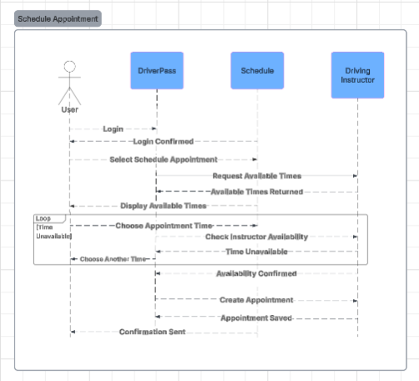
Sequence Diagram
Notes:
This diagram shows how the system handles scheduling a driving lesson step by step. The user selects a time, the system checks instructor’s availability, and if the time is not available, the user is prompted to choose another option. Once availability is confirmed, the system creates the appointment and sends confirmation. This ensures accurate scheduling and prevents conflicts.

Slide 7
Security
Secure login credentials
Protect personal data
Role-based access
Safe data storage
Notes:
Security is an important part of the system design. Users must log in with secure credentials, and their personal and payment information is protected. Access to system features is controlled based on user roles, such as customer or administrator. These measures help ensure the system remains secure and reliable.

Slide 8
System Limitations
Requires internet access
Dependent on system availability
Limited to supported devices
Requires updates over time
Notes:
While the system is designed to be efficient, there are some limitations. Users must have internet access to use the system, and performance depends on system availability. The system may also be limited by device compatibility and will require updates over time to maintain functionality and security.

Slide 9
System Design Overview
User-friendly system
Supports scheduling and training
Scalable cloud-based design
Notes:
Overall, the DriverPass system is designed to be user-friendly and efficient. It supports scheduling, training, and account management while remaining scalable through cloud-based infrastructure. This ensures the system can grow and adapt to future needs.

